Slide 1

Data Mining
پیش پردازش داده ها
بهشیـد بهکمـال
نیمسال اول 1400-1399

Slide 2
Data Preprocessing
Data Preprocessing: An Overview
Major Tasks in Data Preprocessing
Data Cleaning
Data Integration
Data Reduction
Data Transformation and Data Discretization
Summary

Slide 3
Major Tasks in Data Preprocessing

Slide 4
Data Integration

Slide 5
Data Integration
Data integration
Combines data from multiple sources into a coherent store
Data integration issues
Entity identification problem
Redundancy and correlation analysis
Tuple duplication
Data value conflict detection and resolution
5

Slide 6
1. Entity identification problem
Schema integration
Using metadata (like name, meaning, range, type, null rules) avoid errors
e.g., A.cust-id ≡ B.cust-#
Object matching
Identify real world entities from multiple data sources
e.g., Bill Clinton = William Clinton
6

Slide 7
2. Redundancy and correlation analysis
Redundant data occur often when integration of multiple databases
Redundancy in attributes
Naming conflicts: The same attribute/dimension may have different names in different databases
Derivable data: One attribute can be “derived” from another attribute or set of attributes, e.g., annual revenue
Redundant attributes can be detected by:
Correlation analysis: nominal data
Correlation coefficient and Covariance: numeric data
7

Slide 8
Correlation Analysis (Nominal Data)
Χ² (chi-square) test
The larger the Χ² value, the more likely the variables are related
Correlation does not imply causality
# of hospitals and # of car-theft in a city are correlated
Both are causally linked to the third variable: population

Slide 9
Chi-Square Calculation: An Example
Observation Table:
B
 | Male | Female | Sum (row)
Like fiction | 250 | 200 | 450
Not like fiction | 50 | 1000 | 1050
Sum(col.) | 300 | 1200 | 1500
A
Expected values:

Slide 10
Chi-Square Calculation: An Example
Contingency table:
 | Male | Female | Sum (row)
Like fiction | 250(90) | 200(360) | 450
Not like fiction | 50(210) | 1000(840) | 1050
Sum(col.) | 300 | 1200 | 1500
Thus Like_fiction and Gender are strongly correlated for the given group of people.

Slide 11
Chi-Square Distribution Table:

Slide 12
Correlation Analysis (Numeric Data)
Pearson’s correlation coefficient
Measures the statistical relationship, or association, between two continuous variables.
Known as the best method of measuring the association between variables of interest because it is based on the method of covariance.
It gives information about the magnitude of the association, or correlation, as well as the direction of the relationship.
E.g.: Is there a statistical association between IQ scores and depression?

Slide 13
Correlation Analysis (Numeric Data) …
Pearson’s correlation coefficient properties
Limit: Coefficient values can range from +1 to -1
+1 indicates a perfect positive relationship, -1 indicates a perfect negative
Pure number: It is independent of the unit of measurement
E.g., if one variable’s unit of measurement is in inches and the second variable is in quintals, even then, Pearson’s correlation coefficient value does not change.
Symmetric
This means between X and Y or Y and X, the coefficient value of will remain the same.

Slide 14
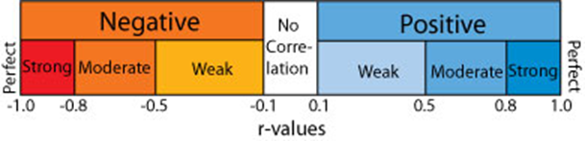
Correlation Analysis (Numeric Data)
Pearson’s Correlation coefficient
n : number of tuples
and : means of A and B,
σA and σB: standard deviation of A and B,
Σ(aibi): sum of the AB cross-product.
r_{A,B} > 0: positively correlated
r_{A,B} = 0: independent
r_{AB} < 0: negatively correlated

Slide 15
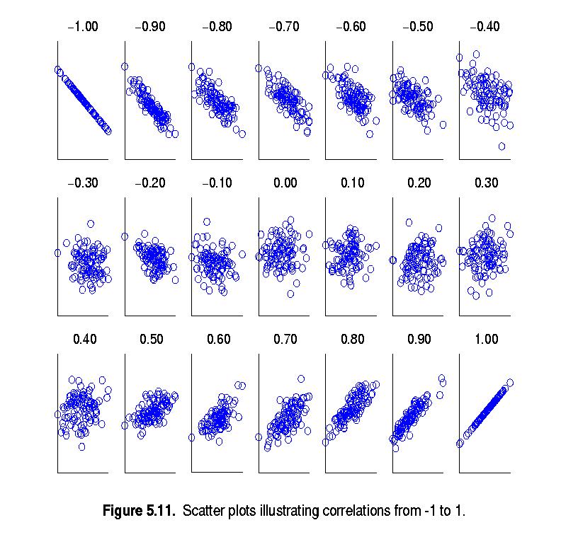
Visually Evaluating Correlation

Slide 16
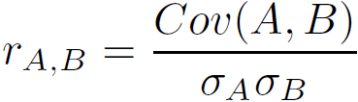
Covariance (Numeric Data)
Covariance is similar to correlation
Positive covariance: If Cov_{A,B} > 0
Negative covariance: If Cov_{A,B} < 0
Independence: Cov_{A,B} = 0 but the converse is not true
Some pairs of random variables may have a covariance of 0 but are not independent. Only under some additional assumptions (e.g., the data follow multivariate normal distributions) does a covariance of 0 imply independence
Correlation coefficient:

Slide 17

Co-Variance: An Example
It can be simplified in computation as
Suppose two stocks A and B have the following values in one week:
(2, 5), (3, 8), (5, 10), (4, 11), (6, 14)
Question: If the stocks are affected by the same industry trends, will their prices rise or fall together?
E(A) = (2 + 3 + 5 + 4 + 6)/ 5 = 20/5 = 4
E(B) = (5 + 8 + 10 + 11 + 14) /5 = 48/5 = 9.6
Cov(A,B) = (2×5+3×8+5×10+4×11+6×14)/5 − 4 × 9.6 = 4
Thus, A and B rise together since Cov(A, B) > 0.

Slide 18
3. Tuple duplication
Two or more identical tuples for a given unique case
The use of deformalized tables (often done to improve performance by avoiding joins) is a source of data redundancy.
Inconsistencies often arise between various duplicates, due to inaccurate data entry or updating some but not all data occurrences.
e.g., in purchase order database: purchaser’s name and address is key. Then the same purchaser’s name appearing with different addresses within the purchase order database.
18

Slide 19
4. Data value conflict detection and resolution
Differences in representation, scaling, or encoding
One university may adopt a quarter system, offer three courses on database systems, and assign grades from A to F,
whereas another may adopt a semester system, offer two courses on databases, and assign grades from 1 to 10.
Differ on the abstraction level
The total sales in one database may refer to one branch of All Electronics, while an attribute of the same name in another database may refer to the total sales for All Electronics stores in a given region.
19

Slide 20
Data Reduction

Slide 21
What is Data Reduction?
Definition: Obtain a reduced representation of the data set that is much smaller in volume but yet produces the same (or almost the same) analytical results
Why data reduction?
A database/data warehouse may store terabytes of data. Complex data analysis may take a very long time to run on the complete data set.
Data reduction strategies
Dimensionality reduction e.g., remove unimportant attributes
Numerosity reduction (some simply call it: Data Reduction)
Data compression ()

Slide 22
Data Reduction 1: Dimensionality Reduction
When dimensionality increases, data becomes increasingly sparse
Dimensionality reduction
Avoid the curse of dimensionality
Help eliminate irrelevant features and reduce noise
Reduce time and space required in data mining
Allow easier visualization
Dimensionality reduction techniques
Wavelet transforms
Principal Component Analysis
Feature selection
Feature Generation
Notes:
22

Slide 23
Fourier transform
Notes:
23

Slide 24
1. Wavelet Transform
Data are transformed to preserve relative distance between objects at different levels of resolution

Slide 25
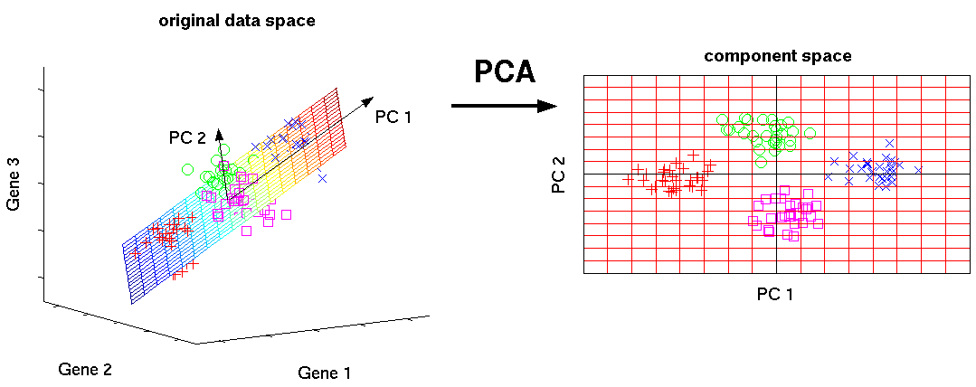
2. Principal Component Analysis (PCA)
Find a projection that captures the largest amount of variation in data
The original data are projected onto a much smaller space
link

Slide 26
Principal Component Analysis (Steps)
Given N data vectors from n-dimensions, find k ≤ n orthogonal vectors (principal components) that can be best used to represent data
Normalize input data
Compute k orthonormal (unit) vectors, i.e., principal components
Each input data (vector) is a linear combination of the k principal component vectors
The principal components are sorted in order of decreasing “significance” or strength
the size of the data can be reduced by eliminating the weak components, i.e., those with low variance
Works for numeric data only

Slide 27
3. Attribute Subset Selection
Another way to reduce dimensionality of data
Redundant attributes
e.g., purchase price of a product and the amount of sales tax paid
Irrelevant attributes
e.g., students' ID is often irrelevant to the task of predicting students' GPA

Slide 28
Heuristic Search in Attribute Selection
There are 2^{d} possible attribute combinations of d attributes
Best single attribute under the attribute independence assumption: choose by significance tests
Methods are typically greedy
Typical heuristic methods:
step-wise forward selection
Step-wise backward elimination
Combination of forward selection and backward elimination
Decision tree induction

Slide 29
Attribute selection: example

Slide 30
4. Attribute Creation (Feature Generation)
Create new attributes (features) that can capture the important information in a data set more effectively than the original ones
e.g. Adding area attribute based on height and width
30
Notes:
30

Slide 31
Data Reduction 2: Numerosity Reduction
Reduce data volume by choosing alternative, smaller forms of data representation
Parametric methods (e.g., regression)
Assume the data fits some model, estimate model parameters, store only the parameters, and discard the data (except possible outliers)
Non-parametric methods
Do not assume models
Major families: histograms, clustering, sampling, …

Slide 32
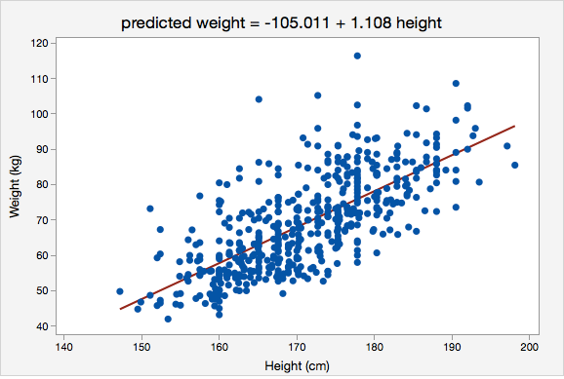
1. Regression Analysis
y
The parameters are estimated so as to give a "best fit" of the data
Most commonly the best fit is evaluated by using the least squares method, but other criteria have also been used

Slide 33
2. Histogram Analysis
Divide data into buckets and store average (sum) for each bucket
Partitioning rules:
Equal-width: equal bucket range
Equal-frequency (or equal-depth)

Slide 34
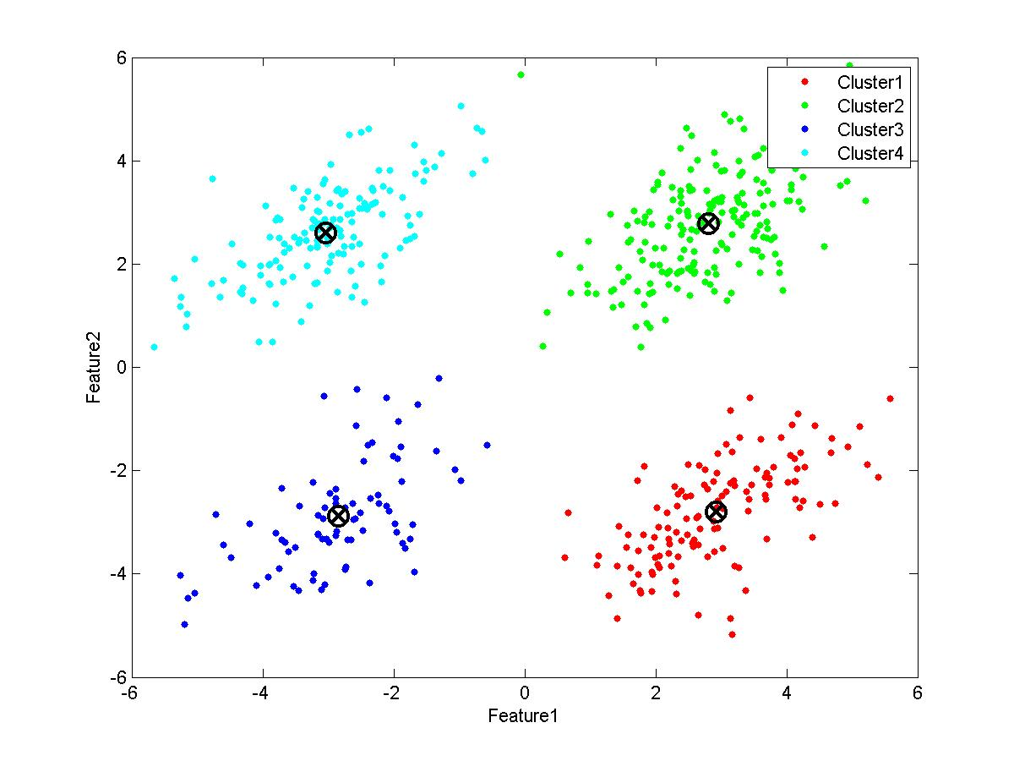
3. Clustering
Partition data set into clusters based on similarity, and store cluster representation

Slide 35
4. Sampling
Sampling: obtaining a small sample s to represent the whole data set N
Key principle: Choose a representative subset of the data
Simple random sampling may have very poor performance in the presence of skew
Develop adaptive sampling methods, e.g., stratified sampling

Slide 36
Types of Sampling
Simple random sampling
There is an equal probability of selecting any particular item
Sampling without replacement
Sampling with replacement
Stratified sampling
Partition the data set, and draw samples from each partition (proportionally, i.e., approximately the same percentage of the data)
Used in conjunction with skewed data

Slide 37
Sampling: With or without Replacement
SRSWOR
(simple random
sample without
replacement)
SRSWR
Raw Data

Slide 38
Sampling: Cluster or Stratified Sampling
Raw Data
Cluster/Stratified Sample

Slide 39
Data Transformation

Slide 40
Data Transformation
A function that maps the entire set of values of a given attribute to a new set of replacement values s.t. each old value can be identified with one of the new values
Methods
Smoothing: Remove noise from data
Attribute/feature construction
Aggregation: Summarization, data cube construction
Normalization: Scaled to fall within a smaller, specified range
Discretization: Concept hierarchy climbing
Notes:
40

Slide 41
Normalization
Min-max normalization: to [new_min_{A}, new_max_{A}]
Ex. Let income range $12,000 to $98,000
normalized to [0.0, 1.0]. Then $73,000 is mapped to
Z-score normalization (μ: mean, σ: standard deviation):
Ex. Let μ = 54,000, σ = 16,000. Then
Normalization by decimal scaling
Where j is the smallest integer such that Max(|ν’|) < 1

Slide 42
Aggregation
Data cube construction

Slide 43
Discretization
Typical methods
Binning
Top-down split, unsupervised
Histogram analysis
Top-down split, unsupervised
Clustering analysis
top-down split or bottom-up merge, unsupervised
Decision-tree analysis
top-down split, supervised
Correlation (e.g., χ²) analysis
bottom-up merge, unsupervised
43
Notes:
43

Slide 44
Concept Hierarchy Generation
Concept hierarchy organizes concepts (i.e., attribute values)
Concept hierarchy formation: Recursively reduce the data by collecting and replacing low level concepts
Concept hierarchies can be explicitly specified by domain experts and/or data warehouse designers
Example of numeric data: age → youth, adult, or senior
Example of Nominal Data: address → street < city < state < country

Slide 45
Automatic Concept Hierarchy Generation
Some hierarchies can be automatically generated based on the analysis of the number of distinct values per attribute in the data set
The attribute with the most distinct values is placed at the lowest level of the hierarchy
Exceptions, e.g., weekday, month, quarter, year
country
15 distinct values
province_or_ state
365 distinct values
city
3567 distinct values
street
674,339 distinct values

Slide 46
Summary
Data integration from multiple sources:
Entity identification problem
Remove redundancies
Detect inconsistencies
Data reduction
Dimensionality reduction
Numerosity reduction
Data compression
Data transformation and data discretization
Normalization
Concept hierarchy generation

Slide 47


